Slide 1

WELCOME TO OUR FINAL SESSION
Introduction to Python Programming Course
Notes:
[Make a copy and edit agenda as per needs]
[Opening slide]

Slide 2

Agenda
30 mins | Project Prep time
1 hr | Project presentations and Feedback
30 mins | What’s next in the field of Python?
GIVING WOMEN THE UNFAIR ADVANTAGE
Notes:
[Keep agenda slide on until Team Presentations]

Slide 3
Agenda
30 mins | Project Prep time
1 hr | Project presentations and Feedback
30 mins | What’s next in the field of Python?
GIVING WOMEN THE UNFAIR ADVANTAGE
Notes:
[Keep agenda slide on until Team Presentations]

Slide 4
Agenda
30 mins | Project Prep time
1 hr | Project presentations and Feedback
30 mins | What’s next in the field of Python?
GIVING WOMEN THE UNFAIR ADVANTAGE
Notes:
[Keep agenda slide on until Team Presentations]

Slide 5






Libraries and frameworks
WEB DEVELOPMENT
Python can be used to make web-applications at a rapid rate.
Python uses frameworks to create these applications.
It has common-backend logic that helps to integrate protocols such as HTTPS, FTP, SSL and even help in the processing of JSON, XML, E-Mail and so much more!
DJANGO
FLASK
PYRAMID
REAL EXAMPLES
TYPE/SHARE YOUR QUESTIONS/COMMENTS IN THE CHAT BOX
Notes:
Brief overview (1-2 mins on each slide only)

Slide 6




Libraries and frameworks
GAME DEVELOPMENT
Python is also used in the development of interactive games.
There are libraries such as PySoy which is a 3D game engine and PyGame which provides functionality and a library for game development.
Gaming industry is a huge and lucrative and very creative sector in tech.
PYSOY
PYGAME
PANDA3D
REAL EXAMPLES
TYPE/SHARE YOUR QUESTIONS/COMMENTS IN THE CHAT BOX
Notes:
Brief overview (1-2 mins on each slide only)

Slide 7

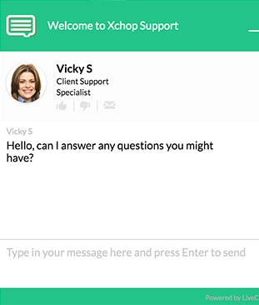
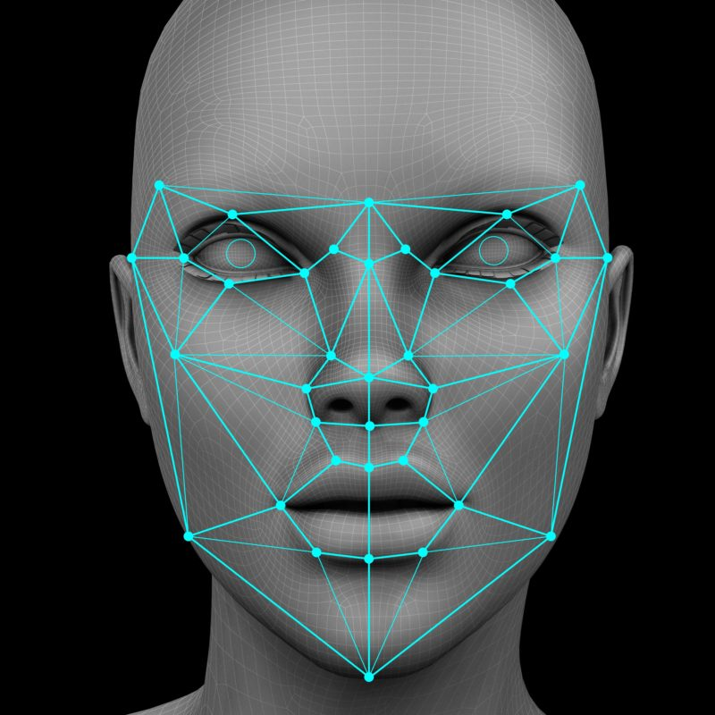
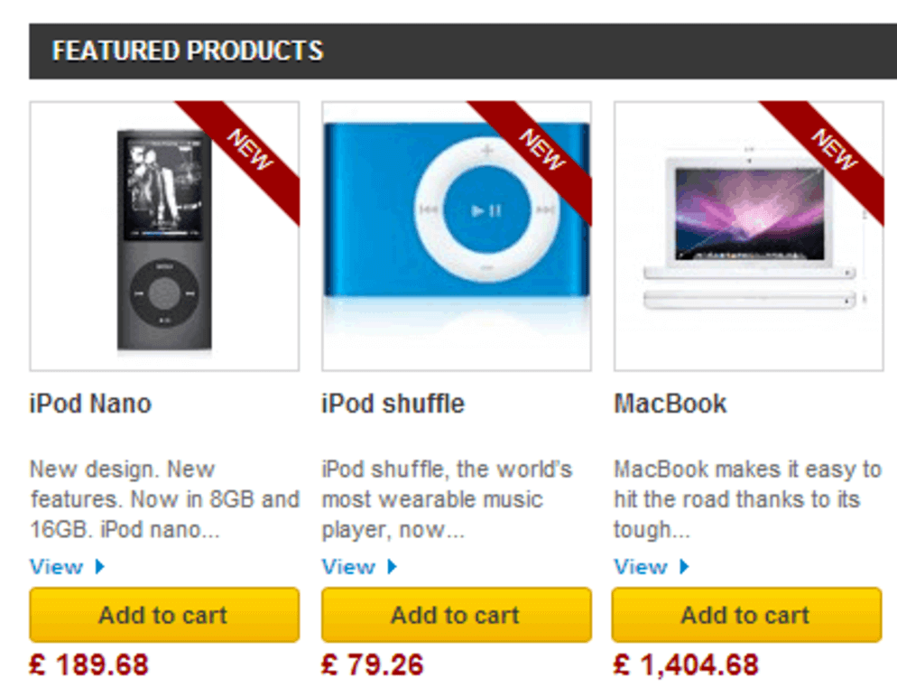
Libraries and frameworks
MACHINE LEARNING & AI
Machine Learning and Artificial Intelligence are becoming more popular as they yield the most promising careers for the future.
We make the computer learn based on past experiences through the data stored or better yet, create algorithms which makes the computer learn by itself.
The programming language that mostly everyone chooses is Python.
PANDAS
NUMPY
SCIKIT-LEARN
REAL EXAMPLES
TYPE/SHARE YOUR QUESTIONS/COMMENTS IN THE CHAT BOX
Online customer support
Face recognition
Product recommendations
Notes:
Brief overview (1-2 mins on each slide only)

Slide 8

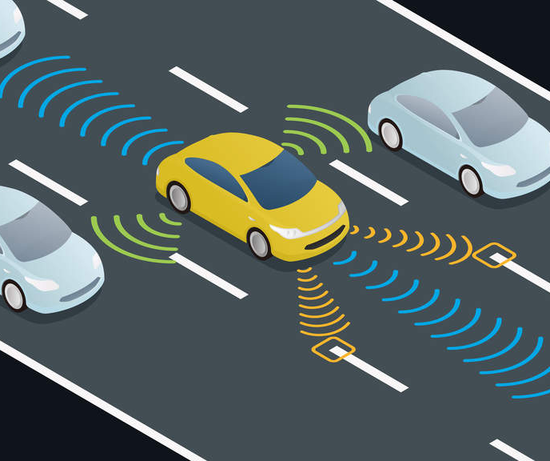
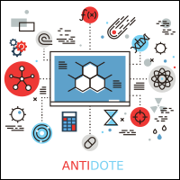

DATA SCIENCE & VISUALISATION
Libraries and frameworks
Data is money and knowledge if you know how to extract relevant information, it would help you to take calculated risks and increase profits.
You study the data you have, perform operations and extract the information required.
Python offers many libraries to become a Data Scientist.
PANDAS
NUMPY
MATPLOTLIB
SEABORN
REAL EXAMPLES
TYPE/SHARE YOUR QUESTIONS/COMMENTS IN THE CHAT BOX
Self-driving cars
New drug discovery
Product development
Notes:
Brief overview (1-2 mins on each slide only)

Slide 9
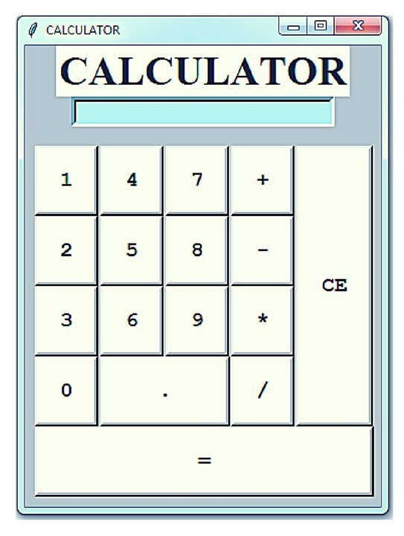
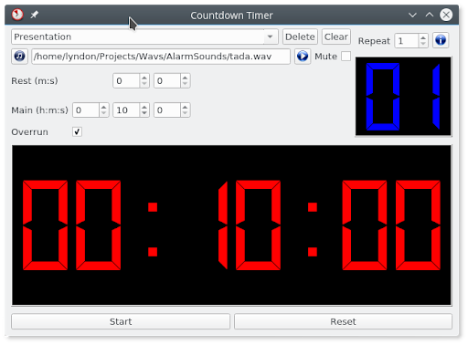
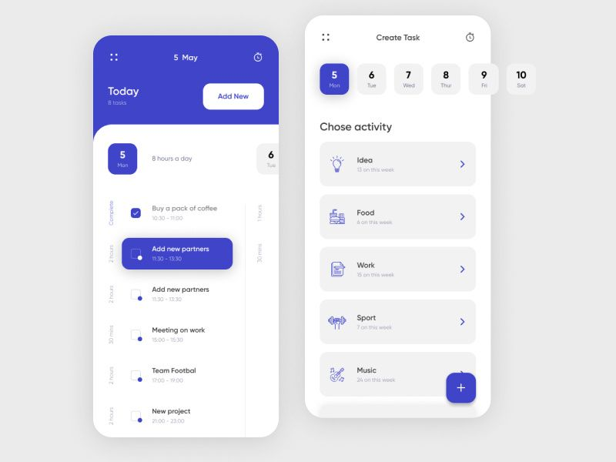
DESKTOP GUI
Libraries and frameworks
Python can be used to program desktop applications.
It provides libraries that can be used to develop user interfaces.
You can start out with creating simple applications such as Calculators, To-Do apps and create much more complicated applications
TKINTER
WGWIDGETS
KIVY
PYQT
REAL EXAMPLES
TYPE/SHARE YOUR QUESTIONS/COMMENTS IN THE CHAT BOX
Calculatr
Countdown
To-do list
Notes:
Brief overview (1-2 mins on each slide only)

Slide 10
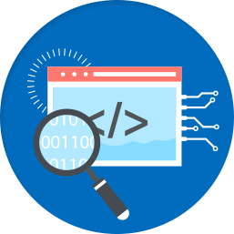



WEB SCRAPING APPLICATIONS
Libraries and frameworks
Python can be used to crawl and then pull a large amount of data from websites
It can be done in real time, which can then be helpful in various real-world processes such as price comparison, job listings, research and development and much more.
The process is called Web scraping or web crawling with Python.
REAL EXAMPLES
BEAUTIFULSOUP
TYPE/SHARE YOUR QUESTIONS/COMMENTS IN THE CHAT BOX
Trading & investment
Travel booking websites
Car hire comparison apps
Notes:
Brief overview (1-2 mins on each slide only)

Slide 11




BUSINESS APPLICATIONS
Libraries and frameworks
Business Applications are different than our normal applications covering domains such as e-commerce, ERP and many more.
They require applications which are scalable, extensible and easily readable and Python provides us with all these features. Platforms such as Tryton can be used to develop such business applications.
REAL EXAMPLES
TRYTON
TYPE/SHARE YOUR QUESTIONS/COMMENTS IN THE CHAT BOX
Notes:
Brief overview (1-2 mins on each slide only)
NB:
Shuup is an enterprise multivendor software platform you can use to build marketplaces like Amazon, eBay, Grubhub, Fiverr, or SkipTheDishes.
Let merchants sell products, services, rentals, and electronic goods through a scalable, multivendor ecommerce marketplace.

Slide 12

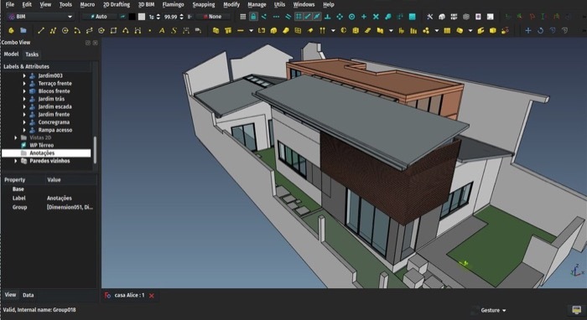
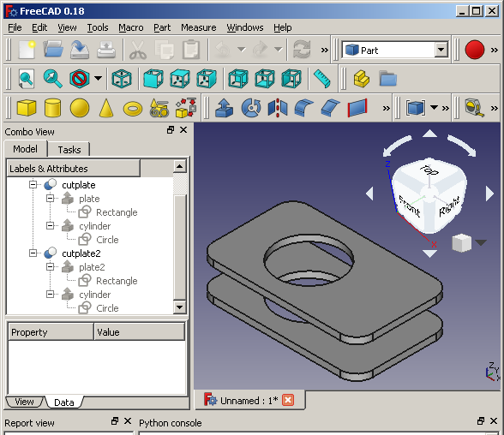
CAD APPLICATION
Libraries and frameworks
Computer-Aided Designing is a very complicated application to make as many things have to be taken care of.
Objects and their representation, functions are just the tip of the iceberg when it comes to something like this.
Python makes this simple too and the most well-known application for CAD is Fandango.
REAL EXAMPLES
FANDANGO
TYPE/SHARE YOUR QUESTIONS/COMMENTS IN THE CHAT BOX
Architecture
Modelling & design
Notes:
Brief overview (1-2 mins on each slide only)

Slide 13

YOUR MOTIVATIONS
Why did you decide to learn Python?
Unmute your mic & share with the group
Notes:
Ask students and encourage 3-4 of them to share with the group

Slide 14

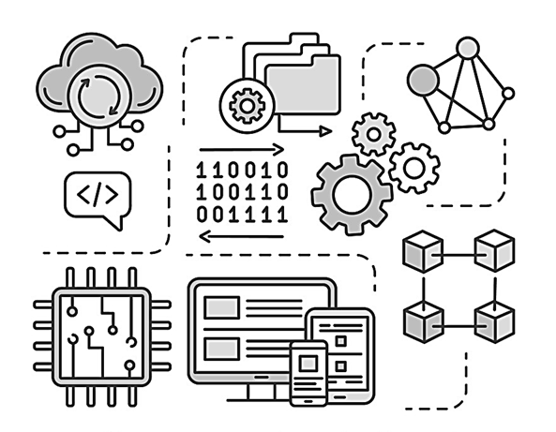
INSTRUCTOR SPEAK
1. What does a day in the life of a Python developer involve?
2. How to prepare effectively for a Python interview?
3. Future learning and resources?
TALK TO
SOMEONE IN THE INDUSTRY TO LEARN WHAT PYTHON IS ALL ABOUT..
Notes:
What are the different career pathways you can explore through Python?
This can either be presented by the instructors themselves or a woman/someone currently working in Tech who can talk to this.

Slide 15
CFG
BY THE END OF 2020, WE WILL BE THE LARGEST COMMUNITY OF FEMALE + NON BINARY CODERS IN THE UK
Notes:
Tech shouldn’t just be a boys club, so everyone at CFG has been working really hard to build a huge community of female tech talent - women like you who can join the tech workforce and can change things for the better.

Slide 16

FIND A JOB YOU LOVE
BUILD YOUR NETWORK
DEVELOP YOUR SKILLS
Notes:
How can Code First Girls help you after you have finished a course? Once you have done a course with us, we can help you connect with the right employer, meet other inspiring women with similar interests and continue to develop your skills in Tech with our courses - online and in-person! The CFG monthly newsletter also has a ton of resources, job opportunities and events - so do sign up and stay in touch.

Slide 17
GIVING WOMEN THE UNFAIR ADVANTAGE
Notes:
Thank you for all your hard work on this course and congratulations again for completing! The CFG mission is to reduce the gap between women and men in tech. The goal isn’t just to teach you to code, but to help create the next generation of leaders - CTOs and CEOs in Tech.

Slide 18
Fill out this form
to claim your
CFG certificate
https://tinyurl.com/careerswitchers
Notes:
[FOR CAREER SWITCHER PAID COURSES ONLY]
Let students know that this link will be sent to them on Slack

Slide 19
Fill out this form
to claim your
CFG certificate
Notes:
[FOR CODING KICKSTARTER FREE COURSES ONLY]
Let students know that this link will be sent to them on Slack

